Slide 1
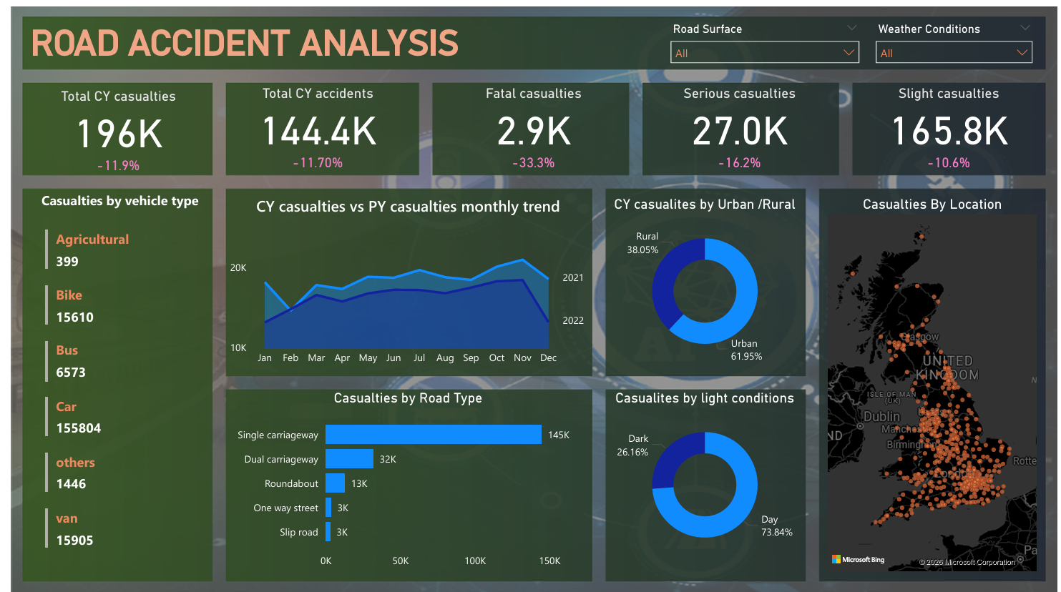

Slide 2
Road Accident Analysis (2021–2022)
Data-Driven Safety Insights | SQL, Power Bi

Slide 3
Business Requirement
The client wants to develop a Road Accident Dashboard to analyze and monitor road safety performance for the years 2021 and 2022, with insights on the following:
🔹 Primary KPIs
Total Casualties (Current Year) & YoY Growth
Total Accidents (Current Year) & YoY Growth
Total Casualties by Accident Severity (Fatal, Serious, Slight) with YoY comparison
🔹 Secondary KPIs
Total Casualties by Vehicle Type (Current Year)
🔹 Trend Analysis
Monthly comparison of Casualties (Current Year vs Previous Year)
🔹 Risk Analysis
Casualties by Road Type (Current Year)
Casualties by Area/Location (Urban vs Rural)
Casualties by Day/Night
🔹 Location-Based Insights
Total Casualties by Location
Total Accidents by Location

Slide 4
Data Model Relationships
Model View Relationships
Created One-to-Many relationship
  Calendar Table (One Side)
  Road Accident Table (Many Side)
  Connected using Date field
Benefit:
Proper filtering across visuals
Accurate time-based calculations
Improved report performance

Slide 5
Data Transformation in Power Bi
Grouping & Categorization
In Power BI:
Grouped Vehicle Types
Grouped Weather Conditions
Grouped Light Conditions
Created calculated measures for:
Total Casualties
Total Accidents
YoY Growth %
Severity-based KPIs
Percentage Distribution
Benefit:
Dynamic filtering
Clean dashboard visuals
Better business storytelling

Slide 6
DAX Measures Created
Total Casualties by filtering the year
Total Accidents by filtering the year
Previous Year Casualties
YoY Growth % for Casualties and Accidents by year
Casualties by Severity
YoY Growth % for Casualties by Serverity
Area % Contribution

Slide 7
Data Preparation (MySQL)
Data Cleaning & Transformation in MySQL
Created new grouping columns:
vehicle_group
weather_group
light_group
Used CASE statements to categorize:
Multiple vehicle types → Car, Bike, Bus, Van, Agriculture, Others
Weather conditions → Fine, Rain, Snow, Others
Light conditions → Day, Night

Slide 8
Monthly Trend Comparison
Monthly Casualties (Peak Month)
2022 Highest Casualties: November – 18,439
2021 Highest Casualties: November – 20,975
Insight:
November is consistently the most accident-prone month.
However, 2022 shows improvement compared to 2021.

Slide 9
Casualties by Accident Severity (2022)
Fatal Casualties: 2,855
Serious Casualties: 27,045
Slight Casualties: 165,837
Insight:
Majority of casualties are Slight (≈ 85%)
Fatal cases are comparatively lower but still critical
Focus needed on reducing serious injuries

Slide 10
Casualties by Vehicle Type
Highest casualties caused by: Car (333485)
Lowest casualties caused by : agriculture (1032)
Insight:
Passenger vehicles (cars) contribute the highest number of casualties, indicating need for stricter traffic monitoring and awareness programs.

Slide 11
Total Casualties & Total Accidents (2022)
Total Casualties (2022): 195,737
Total Casualties (2021): 222,146
YoY Growth: -11.9%
Total Accidents (2022): 144,419
Insight:
There is an 11.9% decrease in casualties in 2022 compared to 2021, indicating improvement in road safety measures.

Slide 12
Casualties by Road Type (2022)
Highest casualties by road type: Single Carriageway( 309,698)
Lowest casualties by road type: Slip road (6600)
Insight:
Single carriageways account for the highest number of casualties, highlighting infrastructure risk in such road types.

Slide 13
Casualties by Weather Condition (2022)
Fine Weather: 156,522
Rain : 26314
Snow :5628
Others: 7273
Insight:
Most accidents occur during fine weather, suggesting that driver negligence may play a bigger role than weather conditions.

Slide 14
Area Distribution (2022)
Urban vs Rural
Urban: 61.94%
Rural: 38.05%
Insight:
Urban areas contribute nearly 62% of total casualties, possibly due to higher traffic density.

Slide 15
Day vs Night Analysis (2022)
Day: 73.8%
Night: 26.15%
Insight:
Most accidents occur during daytime, likely due to increased traffic volume.

Slide 16
Location Analysis
Highest Casualties by Location
Top Location: Birmingham
Lowest location: Orkney islands
Insight:
Birmingham recorded the highest casualties, requiring focused road safety policies and enforcement.
Orkney islands recorded the least casualties

Slide 17
Conclusion & Key Insights
Overall Performance (2022 vs 2021)
Total casualties decreased by 11.9% in 2022 compared to 2021, indicating a positive improvement in road safety.
Total casualties reduced from 222,146 (2021) to 195,737 (2022).
Indicates measurable improvement in road safety performance
Suggests effectiveness of traffic policies and awareness programs
Severity Pattern Analysis
Slight injuries dominate the total casualties
Fatal cases are relatively lower (2,855), but high-impact
Serious injuries (27,045) still represent significant healthcare burden
Vehicle Risk Concentration
Cars contribute the highest number of casualties
Passenger vehicle density in urban regions is a major risk driver

Slide 18
. Seasonal & Monthly Risk
November is the peak accident month in both years:
  2021: 20,975
  2022: 18,439
Geographic Risk Distribution
Urban areas account for 61.94% of total casualties
Daytime accidents account for 73.8%
Birmingham is the highest casualty location
🔎 Insight:
High traffic density and congestion are primary contributing factors.
Infrastructure Risk
Single carriageway roads show the highest casualty count

Slide 19
Casualties by Light Condition (2022)
Daytime Accidents: 73.8%
Nighttime Accidents: 26.15%
Weather Condition Analysis
Casualties by Weather Condition (2022)
Fine Weather: 156,522 casualties
(Highest among all weather conditions
Key Findings:
Slight injuries dominate overall casualty numbers, accounting for the majority of incidents.
Cars are the major contributing vehicle type, indicating higher risk in passenger vehicle traffic.
November is the most accident-prone month in both 2021 and 2022.
Urban areas (61.94%) record significantly more accidents than rural areas.
Daytime accidents (73.8%) are considerably higher than nighttime accidents.
Birmingham is identified as the highest-risk location.
Single carriageway roads show the highest casualty concentration and require infrastructure improvement

Slide 20
Recommendations
1. Strengthen Urban Traffic Control
Improve congestion management in urban areas
Increase monitoring during peak daytime hours
2. Upgrade High-Risk Infrastructure
Improve safety on single carriageway roads
Install better signage and speed enforcement systems
3. Target High-Risk Periods & Locations
Special monitoring during November
Focused intervention in Birmingham
4. Promote Safer Driving Behaviour
Awareness programs for car drivers
Strict enforcement of speed and safety regulations

